Slide 1



Call Center Analysis
BIZ- SaaS-IT
Delmar Bumanglag
Analytics

Slide 2
Agenda
01 | The Importance of a Call Center
02 | KPIs
03 | Dataset / Database
04 | Dashboards
05 | SLAs
06 | Moving Forward

Slide 3



The importance of a call center.

Slide 4
The Key Call Center KPIs
🙂 CSAT (Customer Satisfaction Score) – Average rating (1–5) given by customers after a call.
❌ Abandonment Rate – % of calls where the customer hung up before speaking to an agent.
📤 Escalation Rate – % of calls transferred to a higher support level.
⏱ Average Call Duration – Average length of calls, reflecting complexity and resolution process

Slide 5
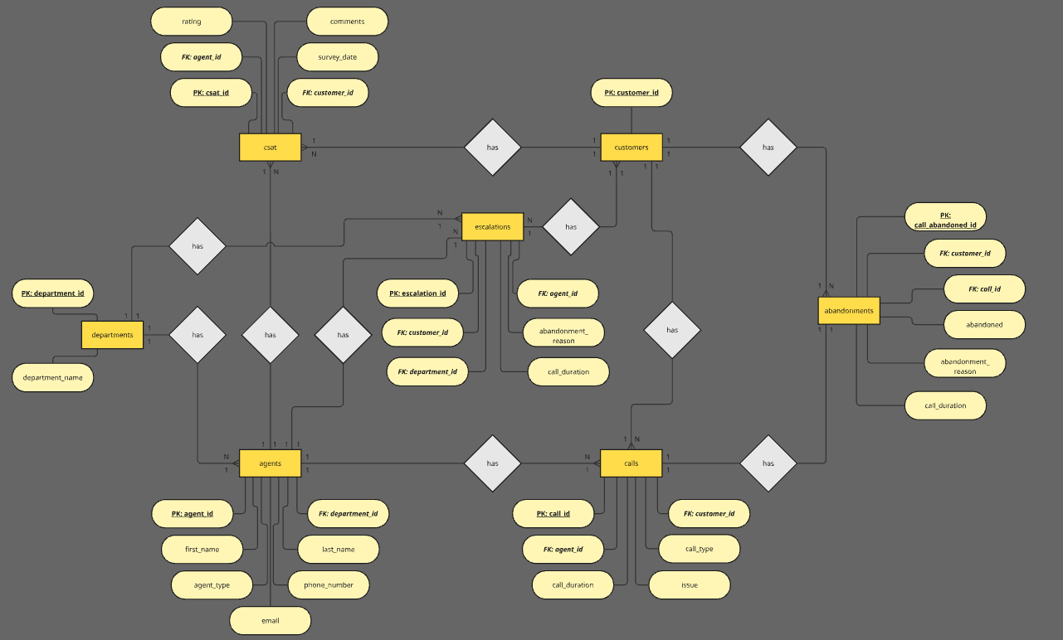
ERD – Entity Relationship Diagram

Slide 6


Microsoft Power BI

Slide 10





SLA integration
Resolution Time
Escalation Handling
1st Response Time
Availability
CSAT Target

Slide 11





Moving Forward
Agent Development
Customer Resources
Focus KPIs
Software
Walkthroughs
Partnership Opportunity

Slide 12
Thank You For your Time
BIZ- SaaS-IT
Delmar Bumanglag
Analytics

Slide 13
References
Benchmarks:
https://www.getfeedback.com/resources/csat-benchmarks https://www.callcentrehelper.com/average-call-handling-time-645.htm https://www.fullview.io/blog/call-abandonment-rate https://www.ladesk.com)
Fotos: https://unsplash.com/photos/woman-in-black-headphones-holding-black-and-silver-headphones-mHusyBu4bxM https://www.pexels.com/photo/a-woman-smiling-while-sitting-on-her-workspace-7658355/ https://www.freepik.com/premium-vector/chatbot-neural-network-ai-servers-robots-technology-cute-chatbot-ai-character_135047598.htm#fromView=keyword&page=1&position=11&uuid=126196cc-31e7-47be-9a55-d80fd4f48fd5&query=Chatbot https://www.freepik.com/free-photo/standard-quality-control-concept-m_36027725.htm#fromView=keyword&page=1&position=8&uuid=ebf01772-40c9-4109-a341-f898f96316f1&query=Documentation

